Slide 1





Kids SmART RMP Summer Camp
Virtual Meet/Greet
May 15, 2024
600-700p

Slide 2
Welcome Parents!
Goals of tonight’s Meet/Greet
  To help families understand the general logistics and structure of our camp
  Make sure children come to camp prepared and ready for fun
  Clarify the process and requirements of scheduling and payments
  To ensure comfort and understanding by parents/guardians and children so we can all have a great time this summer!
  *Virtual introduction of staff will occur after initial presentation, before question/answer portion.

Slide 3
General camp Overview
Camp is open 630a-6p Mon-Fri
  No drop-offs prior to 6:30a
  late fee of $1/min/child assessed for pickups after 6pm
Jeffco camps start Thursday, May 30 and run through August 9
  *All Camps Closed 6/19, 7/4, and 7/5 due to District Building closures
RMP-SW camp starts Monday, June 3 and runs through August 7
  *Camp closed 6/19, 7/4, and 7/5 due to District building closures
RMP-BK:
(text is best)
TBD
Eiber Camp:
(text is best)
TBD
Rose Stein Camp:
(text is best)
TBD

Slide 4
Drop-Off/Pick-up
RMP-BK
*Entrance is on SouthWest side of building, through playground gate
Parents/Guardians MUST come in to drop off/pick up their children- PIN numbers will be set up if you don’t already have one.
Knock LOUDLY, or ring bell. Be patient while we come let you in.
All family members must be approved to pick-up and have their own PIN for check-out.
CCAP families must also check their children in/out on ATS laptop.
Make sure you check the parent table for updated camp information! Parents are responsible for knowing the activities and field trips based on this information.
Eiber
*Park in bus loop on East side of school. Enter through cafeteria doors.
Rose Stein
*Entrance is on North side of building, by playground

Slide 5









Weekly Activity Structure
Mondays:
Swim Days!
Field trip to local pool
Check times on weekly flyer- don’t be late!
Send children IN their suits, with change of clothes
Remember SUNSCREEN and towel
Goggles and life jackets only
Wednesdays:
Field Trip Day!
Field trip to local attractions
District Bus, Kids SmART van, or walking
Check times on weekly flyer- don’t be late!
Tuesdays:
BK: Show up and
Share Day!
Bring ONE camp appropriate item from home to share
Must be labeled; not responsible for lost items
*Stein/Eiber will have Tues Wheels day
Thursdays:
In House/Theme Day!
Extra fun activities surrounding a certain theme, including an edible craft!
*Review Site specific
Activity calendar for more
Information
Fridays:
Outreach!
The field trip comes to us!
Times will be listed on weekly flyer

Slide 6
ECE STUDENTS
*Eiber and rMP-Berkeley 3-5 yr olds
Hello RMP-Berkeley and Eiber Summer Camp ECE Families!
We are so excited to be able to make this summer super fun for your little ones and to ensure all families are ready to go day one we have listed some requests and reminders below:
Provide a change of clothes in a labeled resealable plastic bag to be left on-site and replenished as needed
Send a nap/chill time blanket and sheet for weekly use, blankets will need to go home for washing at the end of each week
Monday/Swim day- Send your child with a life vest for swimming, if applicable. Armies and other floaties are not allowed.
Please make sure to label all the child’s belongings
These reminders are in addition to general camp reminders that can be reviewed on the Camp page of our website: https://www.kids-smart.com/ece-classrooms
Thank you for sharing your children with us and we are looking forward to a fun filled summer with them!
Sincerely,
The Kids SmART Team

Slide 7

Come Prepared!
*things to bring every day
SUNSCREEN!
  Children must have a coat applied prior to drop-off each day
  All children must have sunscreen agreement signed
    If bringing own, be prepared to replenish weekly
    Those who do not complete agreement by 5/25 will automatically be assessed the $50 sunscreen fee.
Breakfast/Lunch
  Will be served (and free!) most of the summer
    Breakfast only available until 8:30a
  We will let you know dates it is not provided (all off site lunches)
  If you have a big eater, or a picky one, feel free to send your child with their own food (must be non-perishable). Please also make sure we have your allergy information
Labeled Water Bottle!
  We can help them refill
Morning and afternoon snack
Monday/Swim day
  They need to wear suit to camp, bring change of clothes and towel. Goggles and life vests allowed; no other floaties or toys

Slide 8
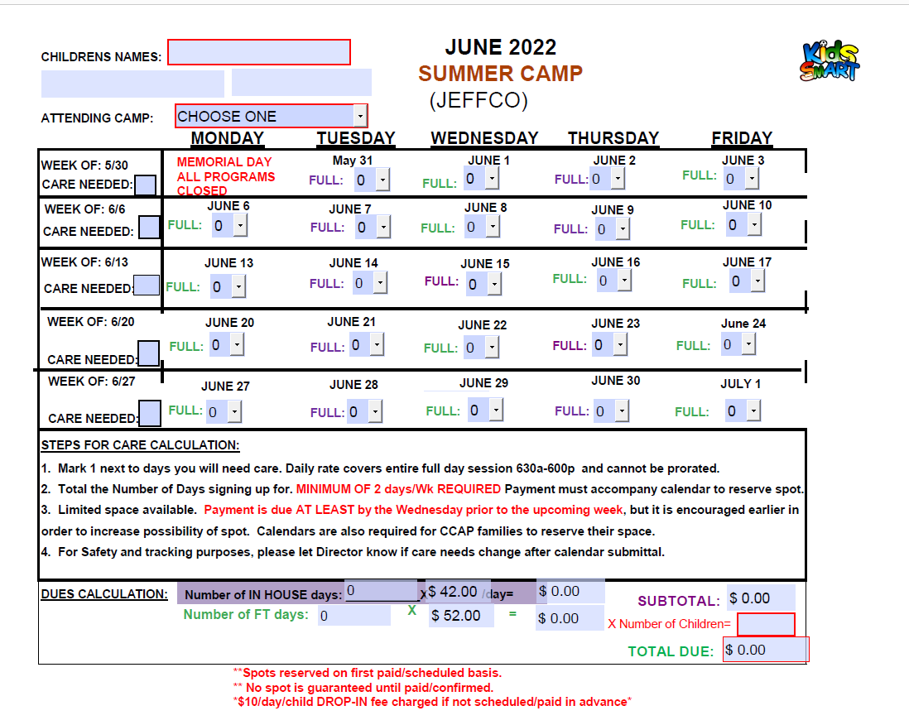
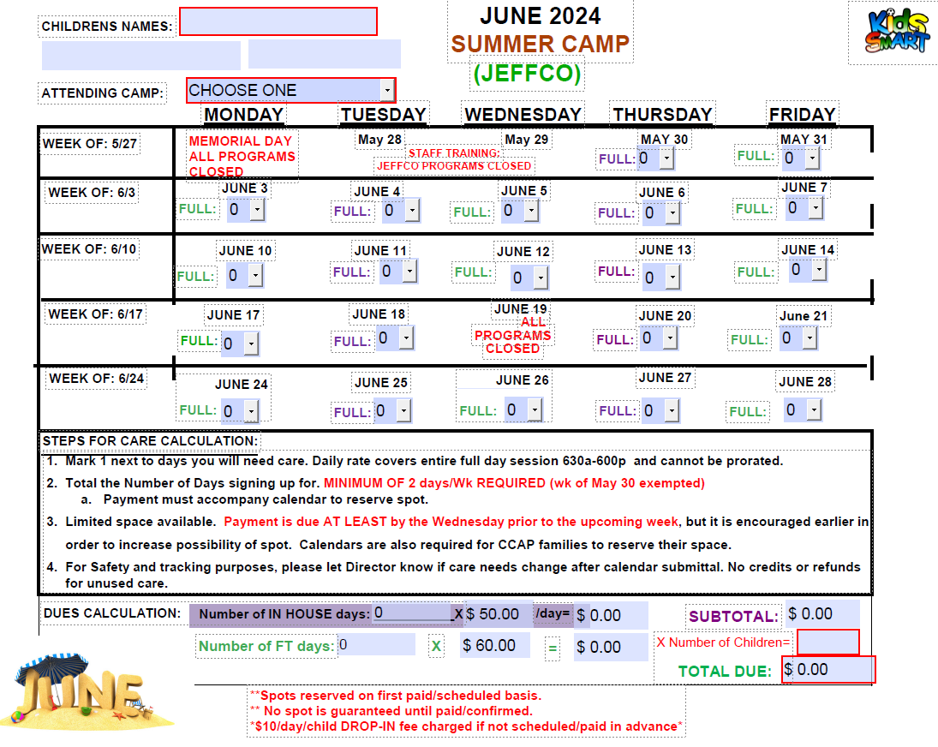
Tuition and Scheduling
Schedules and payments MUST be turned in no later than each Wednesday for the upcoming week (earlier is better!)
No guaranteed spot until paid and scheduled!
  2 day/week minimum on weeks scheduled
CCAP families must schedule as well!!
There are no refunds/credits for unused scheduled/paid days
If not scheduled/paid in advance, you will be charged $10/day drop-in if your child attends (provided there is space)
  Any account carrying a balance will be denied care until paid in full
  Reserved camp spot will be removed if there is B/A balance.
Tuition calendars can be submitted on-site or emailed to admin@kids-smart.com. You can also schedule on www.myprocare.com account 10days-1month in advance.
Payments can be made online via tuitionexpress.com or on-site via cash, check, money order, or credit card. You may also opt to do auto-pay- please email admin@kids-smart.com to sign up.
See tuition calendars on your camps webpage:
www.kids-smart.com/rmpbkcamp
www.kids-smart.com/steincamp www.kids-smart.com/eibercamp

Slide 9
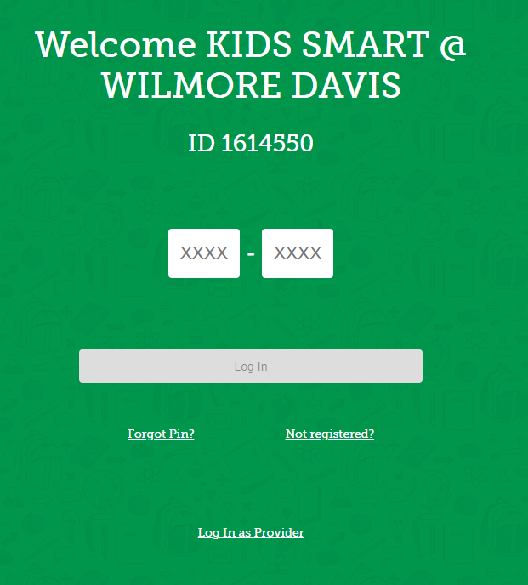
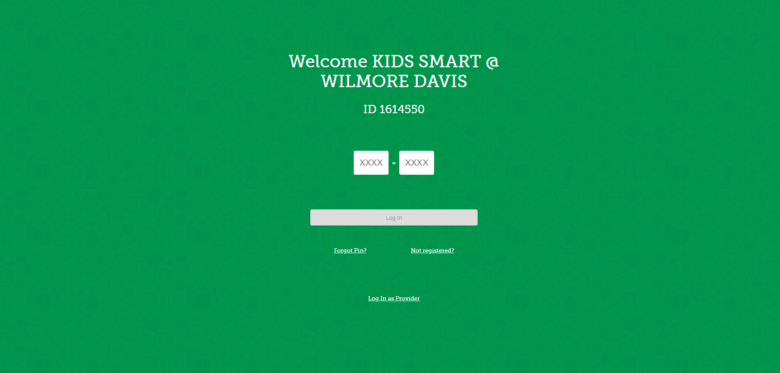
CCAP FAMILIES
Make sure your authorization is transferred to the summer camp site:
  Stein 1708564 Eiber 1780971
          RMP-BK: 1775637
Clock in/outs on ATS each day (or confirming them) is required to avoid out of pocket charges
Parent fees are due by the 1st of the month
Schedules/Calendars are still required to reserve your child’s spot!

Slide 10
Behavior Policy
Safety is our NUMBER ONE priority. If we can’t keep ALL children safe, both physically and emotionally, then we have to take action.
Positive Reinforcement is our main focus, but when needed we will use the 1-2-3 timeout process.
If safety is a concern, we will document with a write-up. Parents/guardians will be notified of write-up upon pickup unless it results in suspension due to safety severity. Generally, we try to follow the policy of 3 write-ups resulting in 2 day suspension.
If we are unable to maintain safety with our approved intervention methods we will call parents to pick up the child. Please know this is our last resort.
PLEASE let us know if your child has any special care needs. The more you keep us informed, the better we can serve your children and ensure an enjoyable time at our camp
*Please review Parent Handbook for additional policies/Procedures

Slide 11

Questions?
Virtual introduction of
The Kids SmART Camp Team

